Slide 1
IT 170 Scripting Languages and Automation
Python Basics

Slide 2
Outline
Basic Concepts: data, computing, programming
Python Overview
Running Python

Slide 3
Info, Data, Computing, & Programming
Information is anything recorded by humans (e.g., symbols on a tree, or scenes in memory)
Data is the representation of Information on computers (PCs/phones/PIs)
Structured: rational databases （data modelled in a scheme）
Unstructured: words, videos
Semi-structured: emails, XML, JSON, NoSQL (not only SQL) (using metadata defines internal structure: grouping, hierarchies)
Computing is a process of using computers to complete a given goal-oriented task. All of computing today is done via programming
Programming is a process of “humans instruct computers”

Slide 4
Basic Programming Terms
Code is commands given to a computer to order it to perform some task
A line of code is generally a single command
A program is a collections of lines of code that can accomplish some tasks (e.g., calculations, face recognition)
Compiling is a process of converting a human-made program to machine codes (machine directly actionable instructions) via a special software called compiler
Compiling includes syntax checking
Executing is a process when a program is actually running

Slide 5
Programming Languages
Levels of programming languages, determined by a few features:
Ease of programming: how closer to natural language; the higher the closer
Portability: across hardware (x86/CISC vs ARM/RISC) and software (Windows vs Linux vs MacOS) platforms
Abstraction from the details of computers: e.g., low-level needs to directly manage memory
Examples
High-level: Python, Java, C#
Middle-level: C
C++ is considered either high- or middle-level, which combines the features as a high-level and assembly languages
Low-level: Assembly language, depending on specific computer architecture
Notes:
ARM: Architecture Reference Manual
Reduced Instruction Set Computing (RISC)
Complex Instruction Set Computing (CISC)

Slide 6
Outline
Basic Concepts: data, computing, programming
Python Overview
Running Python

Slide 7
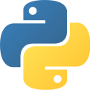

Python Programming Language (src: https://en.wikipedia.org/wiki/Python_(programming_language))
Guido van Rossum, a Dutch programmer who created Python (ver: 0.9.0) in 1991
Python 2.0: 2000 (discontinued in 2020)
Python 3.0: 2008
Python is an interpreted high-level general-purpose programming language. Its design philosophy emphasizes code readability
Python is dynamically-typed and garbage-collected. It supports multiple programming paradigms, including structured (particularly, procedural), object-oriented and functional programming
Python is a "batteries included" language due to its comprehensive standard library
Notes:
dynamically-typed: check if data types are correct after a program starts running.

Slide 8
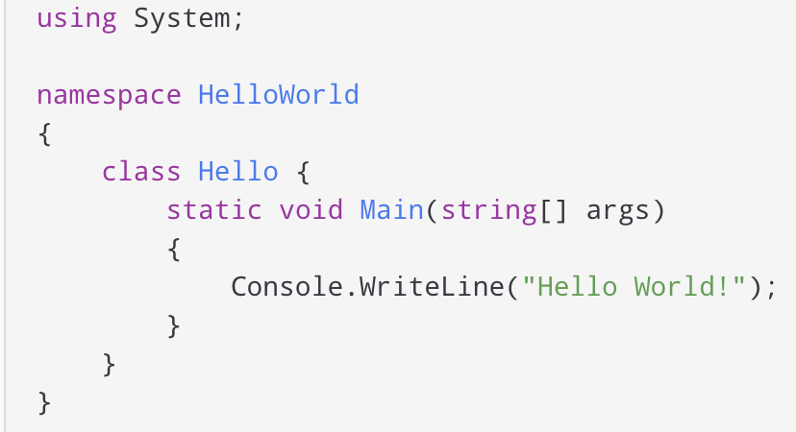
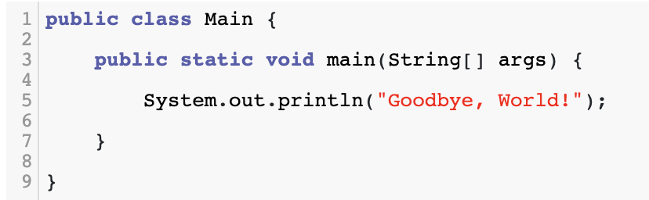

Why Python?
Developers can learn it quickly
Syntax is easy to read
Optimize developer time vs a computer’s processing time
Developer community support
Python as glue
integrating apps developed in different languages
Solving the “Two-Language” problem
Prototyping vs. Production

Slide 9
Why Not Python?
Slower than Java and C++
Not suitable for concurrent, multithreaded applications

Slide 10
Batteries Included
Standard Python Library
Data Analysis with Python
NumPy
pandas
Data Visualization with Python
Matplotlib
Seaborn
Machine Learning Library
Scikit-learn
Notes:
Plug and Play Library

Slide 11
Outline
Basic Concepts: data, computing, programming
Python Overview
Running Python

Slide 12
Program executions—programmer’s view
A Python script (source code file) includes Python statements and has a file extension of .py
One way to run the script is to use the command line by simply typing: python whatevername.py
The result will be shown on the screen, if any.
Second way to run the script/program
Jupyter notebook
Spyder
PyCharm
Visual Studio Code (vs code)

Slide 13
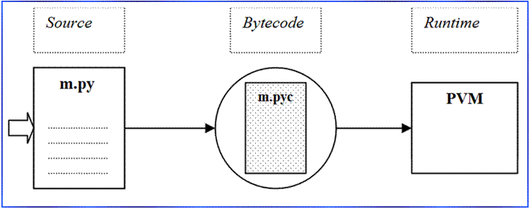
Program executions—what happens behind
Once the execution command is given, the following thing happens:
The source code file is firstly translated (compiled) into a byte code file.
The byte code file is then executed (interpreted) by the Python Virtual Machine (PVM).

Slide 14
Python language implementations
CPython
It is the standard implementation of Python, which is written in C
For Windows users, you can get it from http://www.python.org
For Mac and Linux users, your OS has had CPython installed already.
Jython or JPython
A Java implementation of Python.
It is designed for the integration with Java.
Jython uses Java Virtual Machine to run its programs.
Slower and less robust than CPython.

Slide 15
Python language implementations
IronPython
It is newer than both CPython and JPython
It is designed to work with Microsoft’s .NET framework
From the same creator of JPython
Stackless
Python for concurrency.
PyPy
Python for speed.

Slide 16
Python Installation
Download the Python installation package (for different platforms) from the Python official website
Python Interpreter
Basic programming tools, e.g., IDLE
Download third-party IDE-based Python installation packages: Anaconda (Spyder), PyCharm, etc.
IPython (Interactive Python) & Jupyter Notebooks

Slide 17

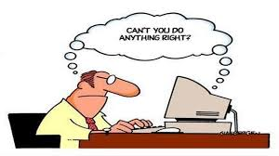
Programming: talking to a computer
OS Shell
Python Shell
User
OS
Programmer
PVM
OS

Slide 18
OS shell vs. Python Shell (shell = interface)
An OS shell (like a command window in Windows) is an interface btw a user and OS
A Python shell is an interface between a programmer and PVM. A Python shell
Can be connected to a local installed PVM
Can be connected to a remote PVM installed on a remote machine
Can be embedded into a Web application called Jyputer Notebook

Slide 19
IPython & Jupyter
Ipython project began in 2001 for a better interactive Python interpreter
Jupyter project started at 2014 for interactive computing tools using different language, including Python
IPython web notebook became Jupyter notebook
The most used programming environment for data science, which seamlessly combined coding, documentation, and presentation

Slide 20
Elements of Python Language
Primitive data types and built-in functions
Control structures
Data structures
Modules & Libraries
Python standard libraries: os, sys, re, math, random, statistics, datetime, etc.
Python packages from third-party: NumPy; pandas; matplotlib; SciPy; scikit-learn; statsmodels
Object-Oriented Programming

Slide 21
Python Basic Semantics
No need for semicolon at the end of a statement
a = 5
Indentation, not braces
for item in aList: print(item)
Everything is an object
Comments (#)
Variables and argument passing
Dynamic references and strong types
a = 5 # a refers to an int
a = “5” # a refers to a string
5 + “5” # error

